Slide 1
How to enable Azure Application Gateway Diagnostic Log?
ICT Precedent Development Group
2021.10.20

Slide 2
Agenda
Below list of items to be followed up
Create Log Analytics Workspace.
Connect Virtual Machine to install/run Log collector Agent.
Enable Azure Application Gateway Diagnostic Settings.
Run Query to check specific logs.

Slide 3
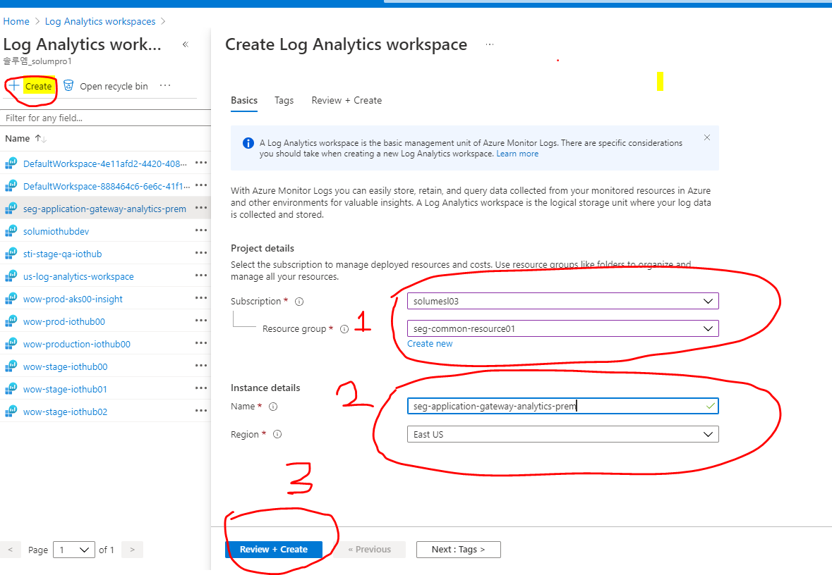
1. Create Log Analytics Workspace
Go to Log Analytics Workspace in Azure portal.
Create a new workspace

Slide 4
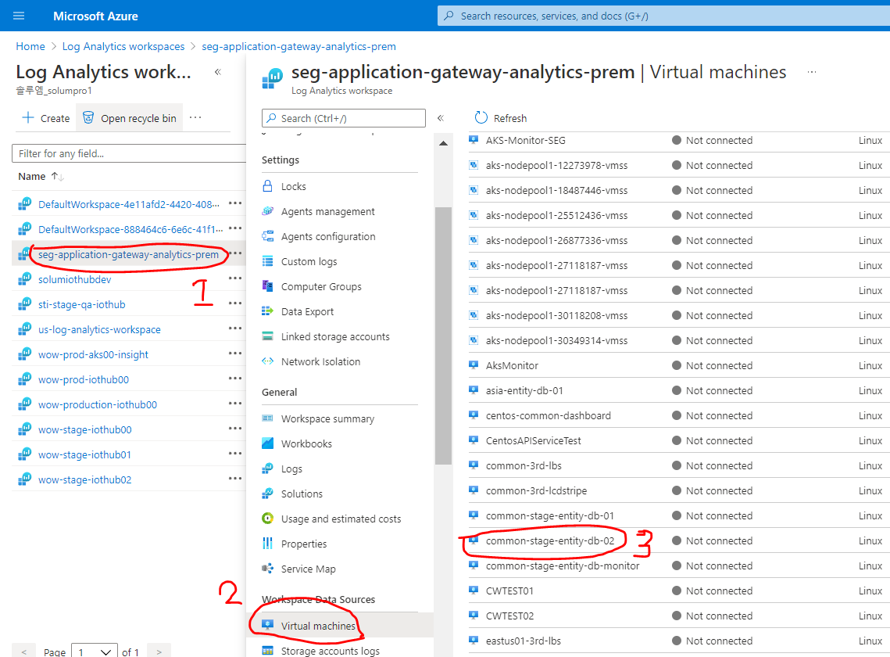
2. Connect Virtual Machine to install/run Log collector Agent.
Choose any existing VM and connect it with the Log Analytics Workspace.

Slide 5
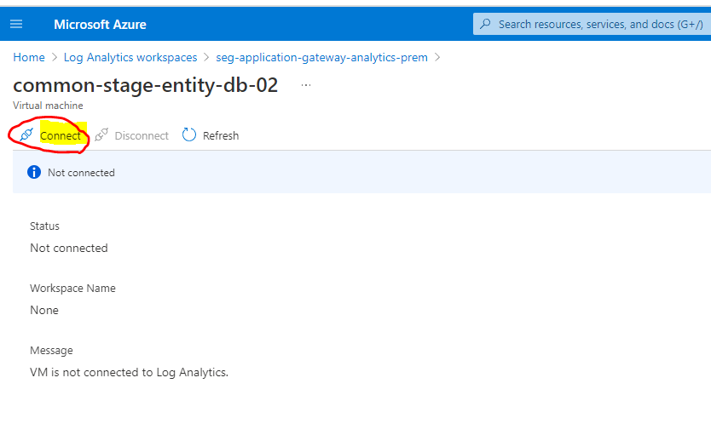
2. Connect Virtual Machine to install/run Log collector Agent.
Connect to the VM and wait until it installs Log monitor Agents automatically inside the VM.
It takes a max of 5 minutes.

Slide 6
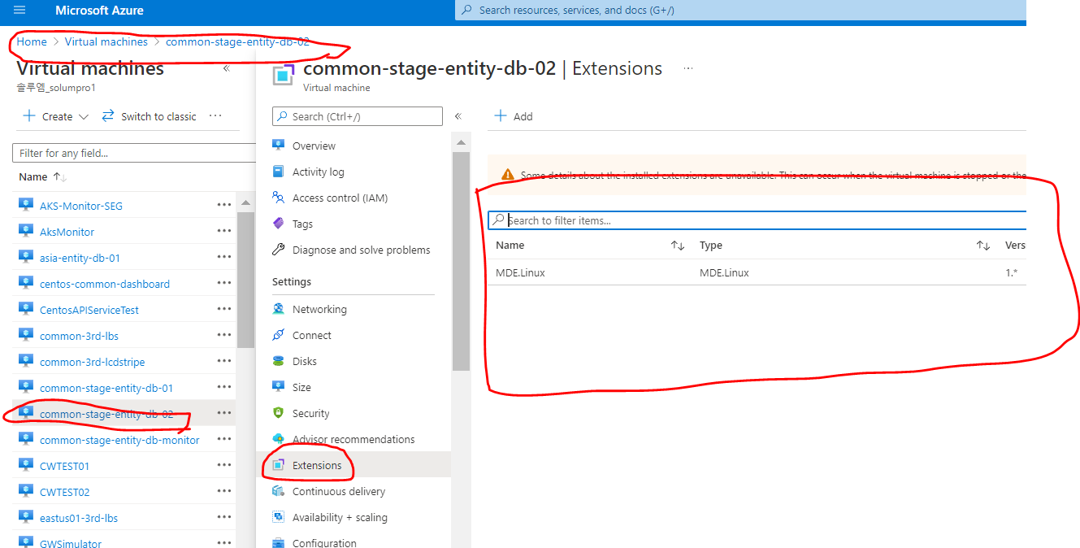
2. Connect Virtual Machine to install/run Log collector Agent.
All the installed agents can be cross verified in Virtual Machine menu in Azure Portal.

Slide 7
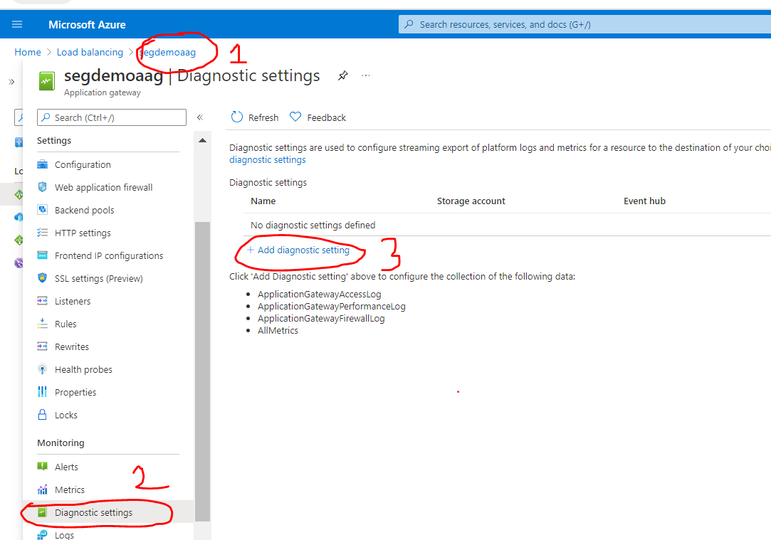
3. Enable Azure Application Gateway Diagnostic Settings
Go to a specific Azure Application Gateway on which Diagnostic Setting has to be enable.
Add a new diagnostic settings.

Slide 8
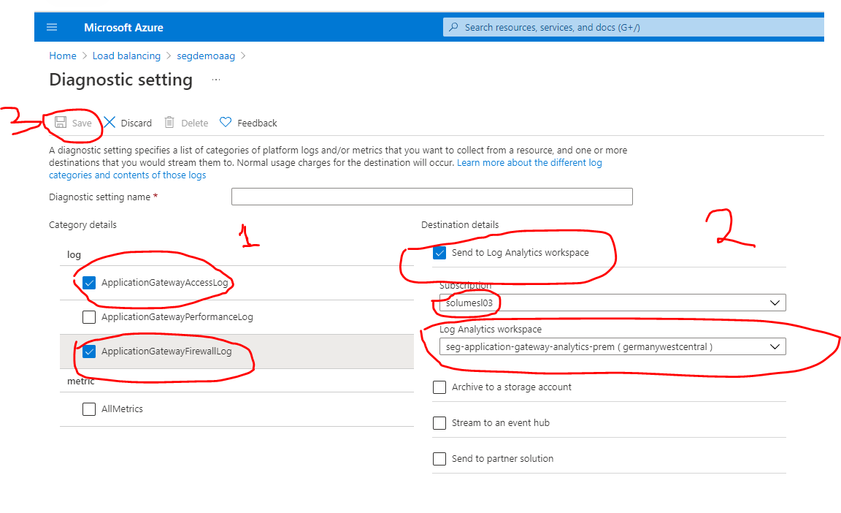
3. Enable Azure Application Gateway Diagnostic Settings
Select different log categories to be used.
Select one of the Log Analytics Workspace, where all logs has to be checked.
Save

Slide 9
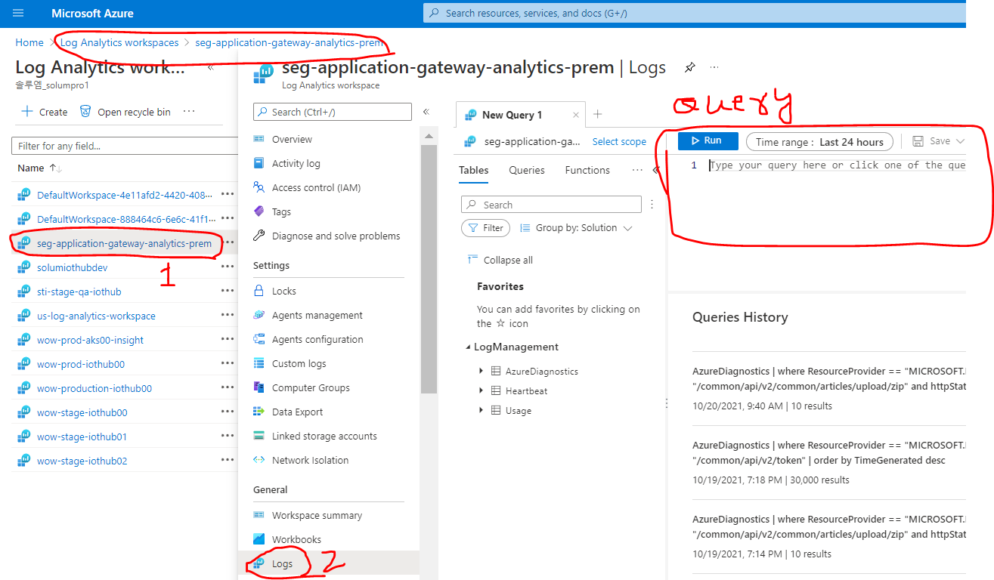
4. Run Query to check specific logs.
Go to Log Analytics Workspace and under log section, we can run queries.

Slide 10
4. Run Query to check specific logs.
Sample queries
AzureDiagnostics
| where ResourceProvider == "MICROSOFT.NETWORK" and Category == "ApplicationGatewayFirewallLog" and requestUri_s == "/common/api/v2/token"
| order by TimeGenerated desc
AzureDiagnostics
| where ResourceProvider == "MICROSOFT.NETWORK" and Category == "ApplicationGatewayAccessLog" and requestUri_s == "/common/api/v2/common/articles/upload/zip" and httpStatus_d == 413
| order by TimeGenerated desc

Slide 11

THANK YOU

